Slide 1

Ly Tu Trong College of Ho Chi Minh City
Subject: English 2
Unit 4: MODIFICATION AND WORD ORDER
Giảng viên: Nguyễn Thị Thanh Tú
Bậc đào tạo: Cao Đẳng Nghề
Học phần: Anh Văn 2

Slide 2
Unit 4:
MODIFICATION AND WORD ORDER
PART VI
INCOMPLETE TEXTS

Slide 3
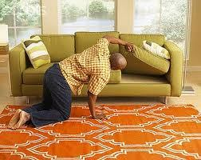
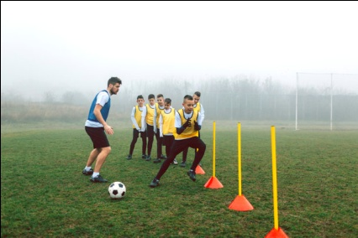
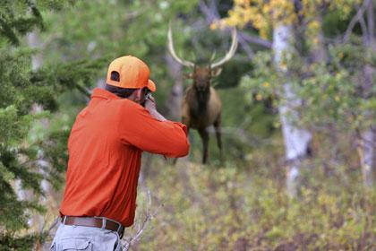

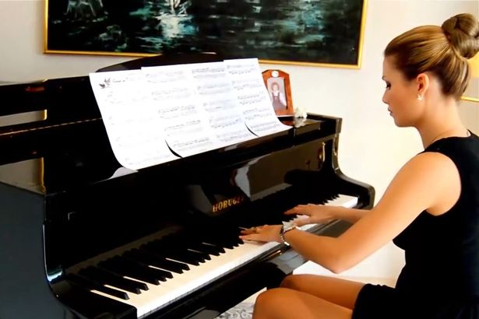
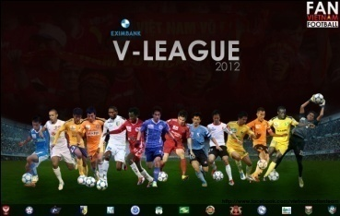
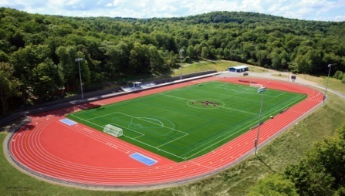
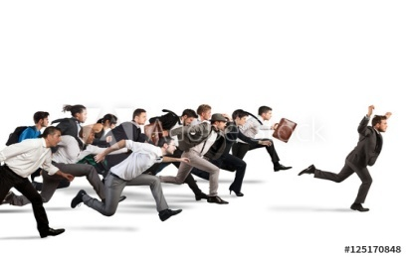
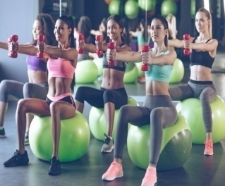
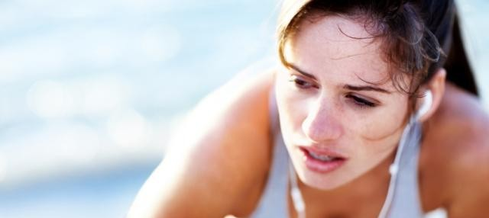
Task 1
MATCH EACH WORD OR EACH PHRASE WITH ITS PICTURE:
1
3
A. league
B. To maintain the position
2
C. The football try-out
4
5
6
D. Athletics field
E. To look for sb/ sth
F. To get burnt out
7
8
9
G. To hunt animals
H. To research
I. To practice playing the piano
J. To exercise
K. competition
10
11

Slide 4
Part IV: Questions 1 through 4 refer to the following notice.
Looking for new players!
The Mayfield High School Football team is (1)___for three new players. 1.(A) looking
(B) hunting
(C) researching
(D) seeking
We are currently leading in the High School league and hope to maintain our position. If you think you are (2)___ to help take our team to the
2. (A) enough good
(B) good enough
(C) enough
(D) good
top for the tenth year in a row, come along to the football try-outs next Friday. We will be holding the try-outs on the athletics field between

Slide 5
Part IV: Questions 1 through 4 refer to the following notice.
7 a.m. and 11 a.m. If this is too early for you, then you (3)____ the
3. (A) isn’t
(B) are not
(C) have not
(D) are
kind of person we are looking for. All regular practices start at 7 a.m., and the team practices 5 days a week. We would like to encourage all students who made it to the short list last time (4)______ again. 4. (A) try
(B) to try
(C) trying
(D) tried

Slide 6
Part IV: Questions 1 through 4 refer to the following notice.
7 a.m. and 11 a.m. If this is too early for you, then you (3)____ the
3. (A) isn’t
(B) are not
(C) have not
(D) are
kind of person we are looking for. All regular practices start at 7 a.m., and the team practices 5 days a week. We would like to encourage all students who made it to the short list last time (4)______ again. 4. (A) try
(B) to try
(C) trying
(D) tried

Slide 7
Part VI: questions 1 through 4
The Mayfield High School Football team is (1)_____________for three new players.
1.
We are currently leading in the High School league and hope to maintain our position.
(A) looking
(A) looking
(B) hunting
(C) researching
(D) seeking

Slide 8
Part VI: questions 1 through 4
If you think you are (2)________ to help take our team to the top for the tenth year in a row,
2.
come along to the football try-outs next Friday.
S + be + adj + enough + to_V
S + V + adv+ enough + to_V
(regular)
S + have/has + enough + N +
(A) enough good
(B) good enough
(B) good enough
(C) enough
(D) good

Slide 9
Part VI: questions 1 through 4
We will be holding the try-outs on the athletics field between 7 a.m. and 11a.m. If this is too early for you, then you (3)____ the kind of person we are looking for. 3.
(A) isn’t
You isn’t
(B) are not
(B) are not
You don’t have
You have not + P.P
(C) have not
(D) are
then (adv) = immediately /i'mi:djətli/(adv)

Slide 10
Part VI: questions 1 through 4
We would like to encourage all students who made it to the short list last time (4)______ again.
4. (A) try
(B) to try
(C) trying
(D) tried
To encourage /in'kʌridʒ/ sb + to V
Ex: Teachers encourage students to do homework at home.
My parents encourage me to study hard.
To encourage (v): to make sb believe it is a good thing to do
(B) to try

Slide 11
VOCABULARY

Slide 12
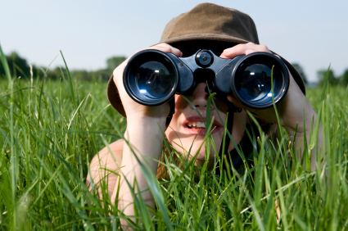
1/ to look for somebody/ something (v): try to find sb/sth
= to seek /si:k/sb/sth

Slide 13
2/ to hunt /hʌnt/ sth: to find animals or birds for food, sports or to make money

Slide 14
3/ to research /ri'sə:t∫/sth (v): to study sth carefully and try to find out new facts
→research (n): a careful study a subject to find out new facts

Slide 15

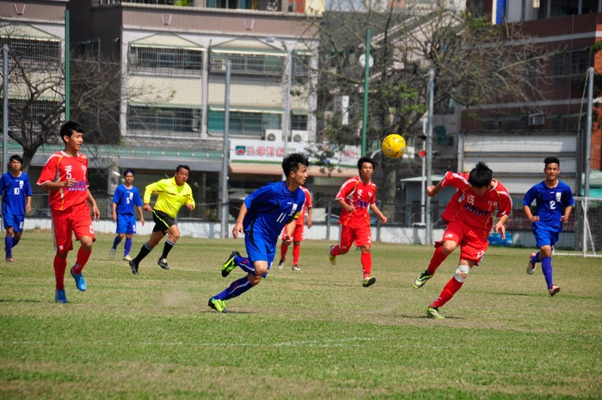
4/ High School league /li:g/

Slide 16
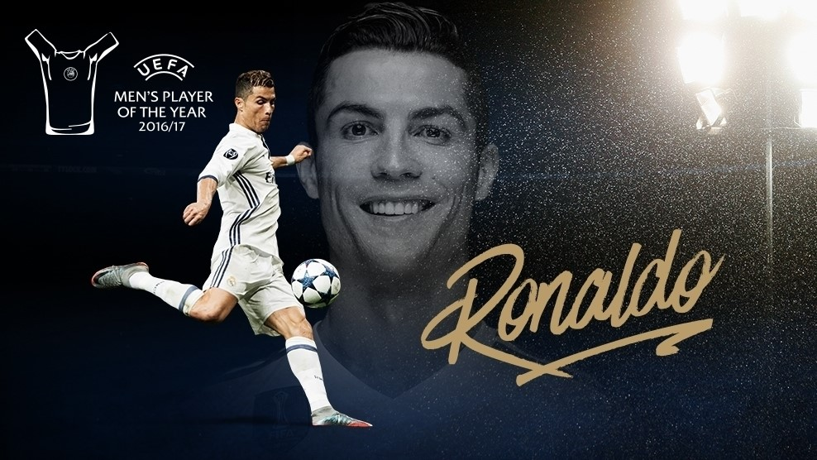
Cristiano Ronaldo has won Best Fifa Awards for five times. He maintains the position “the men's player of year”
To maintain /mein'tein/ (v) sth: to make sth continue at the same level, standard

Slide 17

6/ Try-outs (n): tests to find the best players for a football team or sports team.

Slide 18
7/ Regular /'regjulə/ (adj)= usual → regularly = usually (adv)
8/ to come along (v): to arrive; to appear
Ex: If you think you are a good football player, come along to / arrive at the football try-outs next Friday.

Slide 19
9/ To practise/ practice /'præktis/ + V_ing: to do an activity regularly so that you can make your skill better.
Practice (n): doing an activity regularly so that you can make your skill better.
Ex: She usually practices playing the piano at night.
She has regular practices of playing the piano at night.

Slide 20
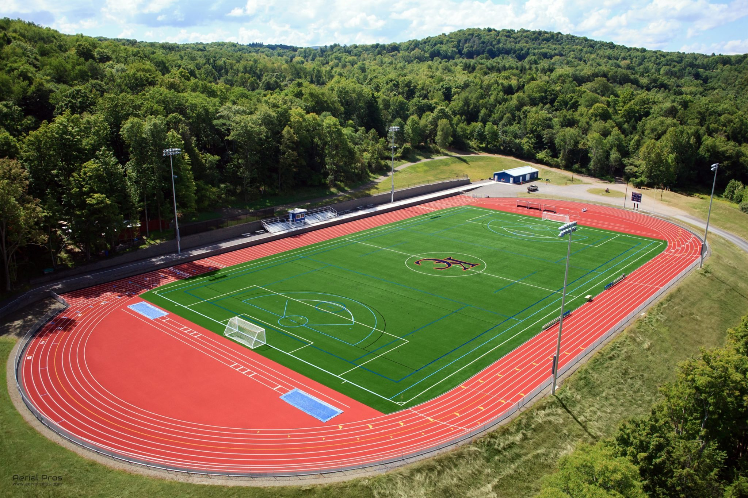
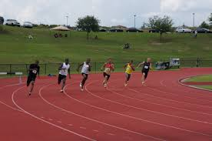
10/ Athletics field /æθ'letiks fi:ld/ =
My school has a big athletics field.
stadium

Slide 21
Part IV: Questions 5 through 8 refer to the following information.
You are never too young or too old to get involved in sports and exercise. In fact the sooner you start to (5)_____, the better.
5. (A) exercising
(B) sport
(C) sporty
(D) exercise
According to some recent research, people who started sports at a young age were more likely to keep it up as they got older. This applied whether they were involved in (6)____ sports or not.
6. (A) competition
(B) competitive
(C) competing
(D) competitions

Slide 22
Part VI: (cont.)
In fact, people who did sports just for fun when they were younger were about 7% more (7)_____ to keep exercising when they were older.
7. (A) like
(B) likeable
(C) likely
(D) liking
Researchers believe this might be because some young people get burnt out from competition. However, even people who gave up sport because they felt burnt out tended to return to exercising (8)_______ years later. So start exercising now, if you want to be
8. (A) few
(B) a few
(C) a
(D) another
strong and healthy later!

Slide 23
Part VI: questions 5 through 8
You are never too young or too old to get involved in sports and exercise. In fact the sooner you start to (5)_____, the better.
5. (A) exercising
(B) sport
(C) sporty
(D) exercise
Ex: We start to learn English at 12:30 p.m. on Monday.
We start learning English at 12:30 p.m. on Monday.
(D) exercise
to start /stɑ:t/ + to V / V-ing = to begin doing or using sth.

Slide 24
Part VI: questions 5 through 8
This applied whether they were involved in (6)____ sports or not.
6. (A) competition
(B) competitive
(C) competing
(D) competitions
To get/be involved in sth:
competition /kɔmp∂'ti∫n/ (n)
→Competitions (plural)
competitive /kəm'pet ∂ tiv] (adj)
compete /kəm'pi:t/ (v)
competing (V_ing)
competed (V_ed)
(B) competitive
Adjective
Noun
modifies

Slide 25
Part VI: questions 5 through 8
In fact, people who did sports just for fun when they were younger were about 7% more (7)_____ to keep exercising when they were older.
7. (A) like
(B) likeable
(C) likely
(D) liking
To like (v) = enjoy (v)
Likeable /'laikəbl/ (adj)
(C) likely
Likely (adj) ; (adv)
Comparative:
More + noun
More + long ADJ/ Short ADJ+ER
More + ADV

Slide 26
Part VI: questions 5 through 8
However, even people who gave up sport because they felt burnt out tended to return to exercising (8)_______ years later.
8. (A) few
(B) a few
(C) a
(D) another
Few + plural Noun = not many
(B) a few
A few + plural Noun = a small number, some
A + singular Noun
Another + Singular Noun

Slide 27
Vocabulary
11. to start + to V/ V_ing = to begin + to V/ V_ing
Ex: If you want to be stronger and healthier, start exercising/ to exercise.
12. to be/ get/ become involved in sth: to take part in sth
Ex: You are never too young or too old to get involved in sports and exercise.

Slide 28
Vocabulary
13. compete /kəm'pi:t/ (v): to try to be better than others; to take part in a contest or game (test)
→competition /kɔmp∂'ti∫n/ (n): an event in which people compete with each other to find out who is the best at sports /sth
→Competitions (plural) ex: a music/photo competition
→ competitive /kəm'pet ∂ tiv] (adj)

Slide 29



He came first in a running competition

Slide 30
14. Exercise /'eksəsaiz/ (n): physical or mental activity that you do to become stronger.
To exercise (v): to do sports or physical activity to make your body stronger.
15. Burnt out (adj): feeling of being too tired
To get/ feel burnt out (v): to get/ feel very tired

Slide 31
14. Likeable /'laikəbl/ (adj): pleasant and easy to like
Ex: She’s friendly and likeable.
likely /'laikli/ (adj) : probable /'prɔbəbl/
Ex: Tickets are likely to be expensive.
Likely (adv): very probably
Ex: The illness was caused, most likely, by a virus.

Slide 32

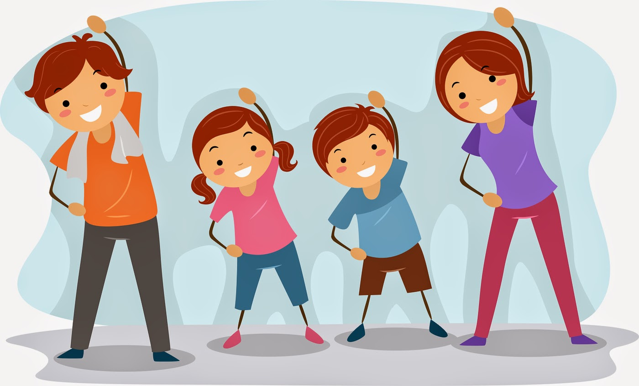

Slide 33

She looks very tired/ burnt out

Slide 34
TASK 2: FILL IN THEBLANKS WITH THE SUITABLE WORDS OR PHRASE:
exercise looking for athletics field likely
hunt burnt out competitive competition
1. We are ____________ someone with experience for this position.
2. Lions sometimes ___________ alone.
3. The doctor advised him to do more _____________.
4. There is a big __________________ in our school.
5. I’m feeling ____________ at work - I need a holiday.
6. We are in _____________ with four other companies for the contract.
7. They sell good computers at very______________ prices.
8. The illness was caused, __________, a by a virus.
looking for
hunt
exercise
athletics field
burnt out
competition
competitive
likely

Slide 35
Questions 9 through 12:
9. B 10. A 11. C 12. C
1Strategically (adv):
2. To score goal(v): to kick a ball into your opponents’ goal.
3. To keep up the pace (v): to increase the same speed as sb/sth
4. Rumor (n): a piece of information, or a story, that people talk about, but may not be true.

